Slide 1
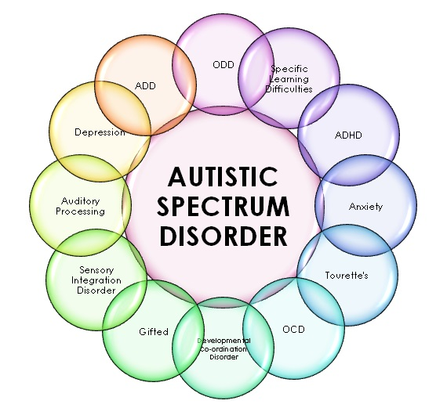
A Machine Learning Approach To Predict
Autism Spectrum Disorder
(DSCI 6002 – Intro to Data Science) Group 9: Sort Out

Slide 2
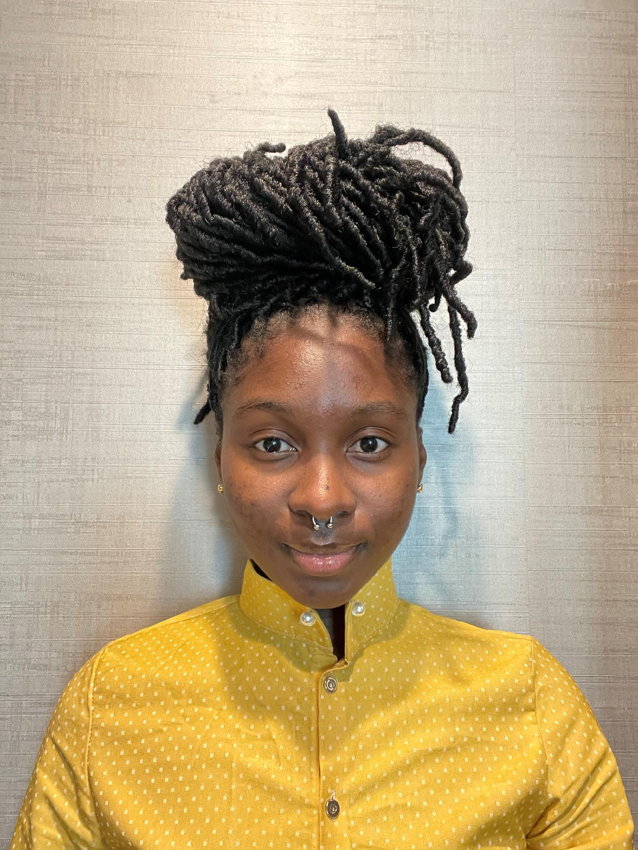
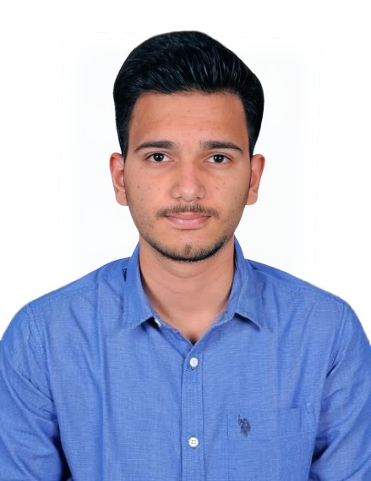

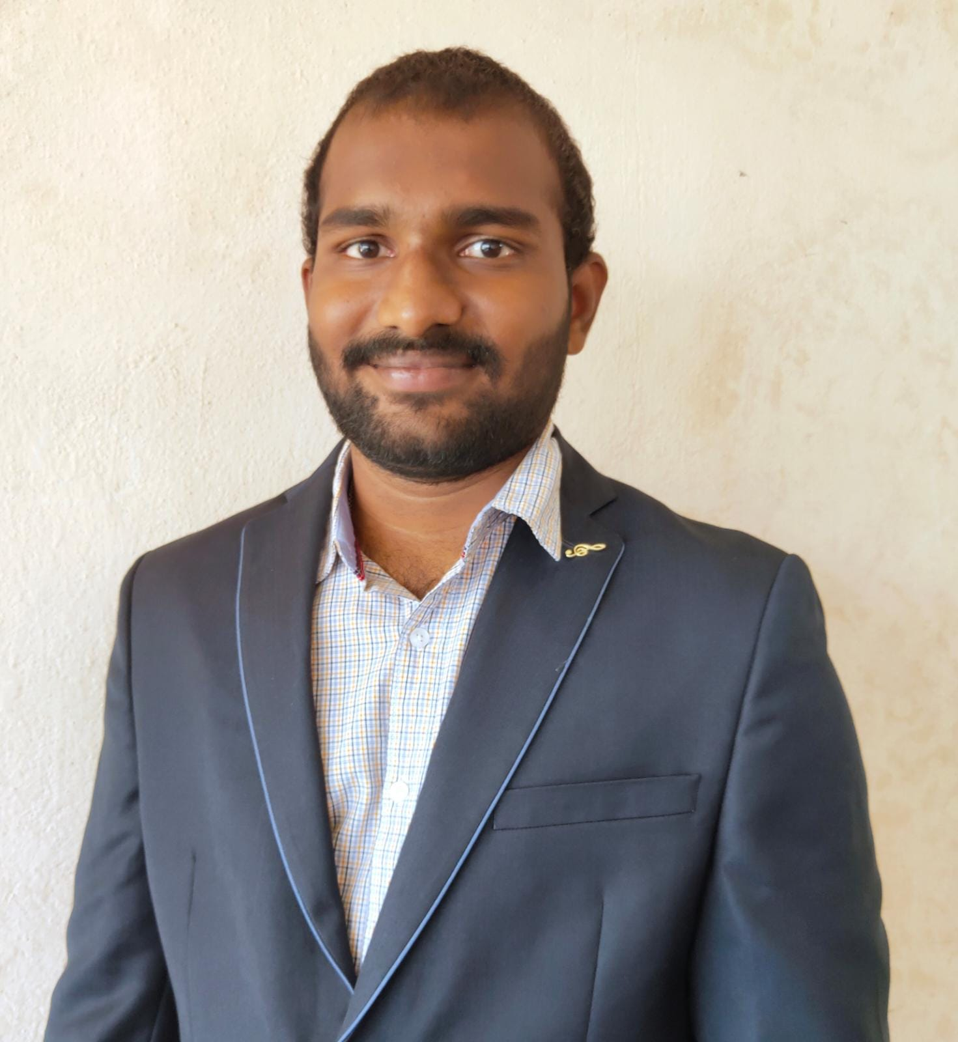


MEET THE TEAM
SELINAM SETRANAH
DEVNATH REDDY MOTATI
AJAY KUMAR JAGU
AVINASH REDDY BHAVANAM
KRISHNA SURENDRA PALEPU

Slide 3
INTRODUCTION
Autism spectrum disorder is a neurodevelopmental disorder that affects a person’s interaction, communication and learning skills.
People with ASD may behave, communicate, interact, and learn in ways that are different from most other people.
People with autism might have problems with learning disabilities, mental health problems such as anxiety, depression, motor difficulties, sensory problems ,etc.
The common symptoms that an autistic person shows are lack of eye contact, a narrow range of interests or intense interest in certain topics, doing something over and over, like repeating words or phrases, high sensitivity to sounds, touches, smells, or sights that seem ordinary to other people, Not looking at or listening to other people etc.

Slide 4
PROBLEM STATEMENT
The goal is to design and implement a system, which will be able to efficiently detect autism spectrum disorder(ASD) using machine learning algorithms.

Slide 5
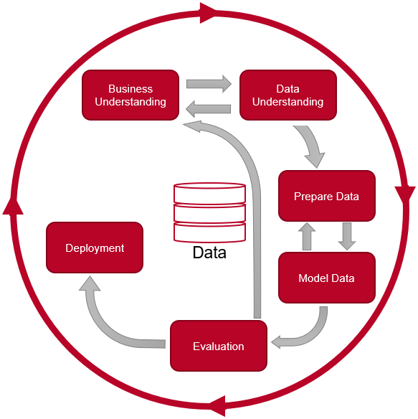
CRISP-DM

Slide 6
BUSINESS UNDERSTANDING
In present day Autism Spectrum Disorder (ASD) is gaining its momentum faster than ever. Detecting autism traits through advanced screening tests is very expensive and time consuming. With the advancement of artificial intelligence and machine learning (ML), autism can be predicted at quite an early stage.
Earlier detection of autism can come to a great help by prescribing patients with proper medication at an early stage. Thus, a time efficient, accurate and easy screening test tool is very much required which would predict autism traits in an individual and identify whether or not they require comprehensive autism assessment.

Slide 7
DATA UNDERSTANDING
Here data from kaggle is used. It is based on 10 screening questions focused on different domains such as; attention to detail, attention switching, communication, imagination and social interaction. For each question, it is either 1 or 0. It also contains certain features such as Age, Gender, If born with Jaundice, Family members with ASD and the person completing the test.

Slide 8
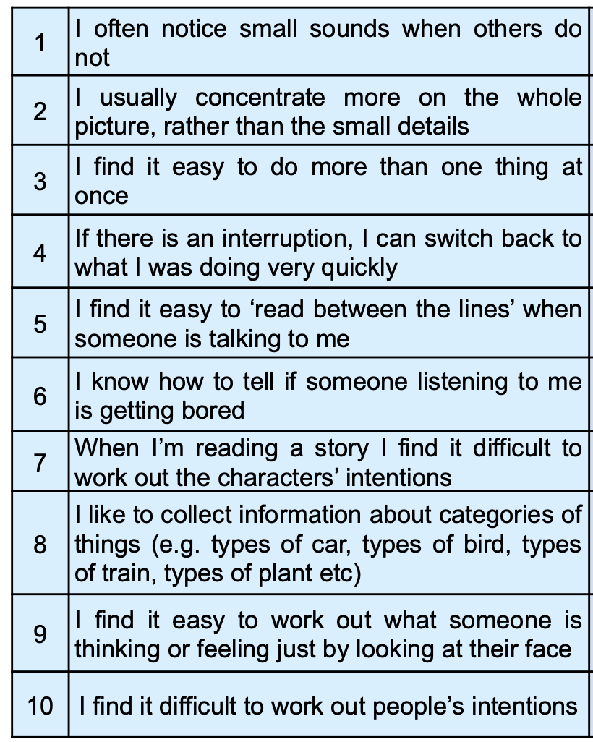

10 Screening Questions

Slide 9
PREPARING THE DATA
The collected data is explored and analyzed and remove irrelevant features.
Observations with null columns are removed.
And categorical string values are encoded for the model.(yes to 1 and no to 0)
CHOOSING A MODEL
Multiple machine learning algorithms were trained and tested.( Random forest, SVM etc)
The Random Forest algorithm gave high accuracy compared to others.

Slide 10
EVALUATION
The ingested data is divided into 80% training data which is used for training the model.
The model is trained using Machine Learning algorithm Random Forest.
The other 20% of the ingested data is used for testing the trained model.
Once the model is trained and tested, the performance of the model is evaluated.
DEPLOYMENT
Deployed the model in the web using flask.
The model can be accessed via http://127.0.0.1:5000/index .
Input: AQ-10 answers and certain other attributes such as Age, Gender , Family member with autism and Born with jaundice .
Output: Whether the person has autism or not.

Slide 11
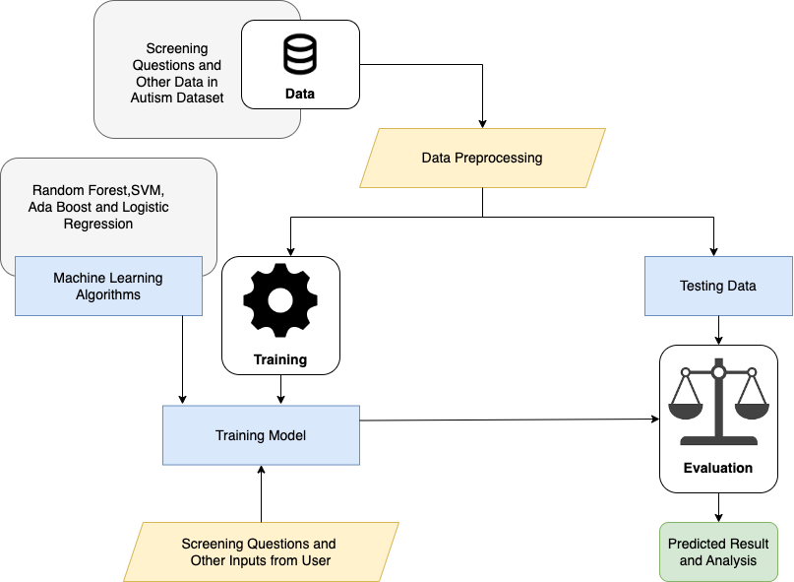
SYSTEM ARCHITECTURE

Slide 12
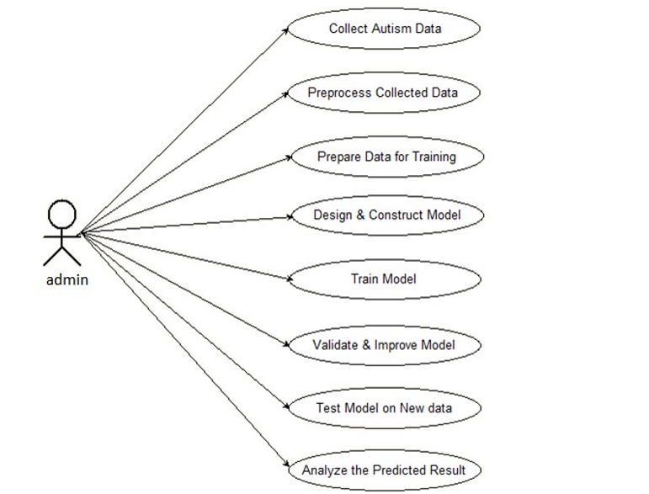
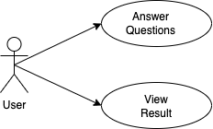
USE CASE DIAGRAM

Slide 13
DEMO
Let us now go through the working of our project.

Slide 14
Conclusion
A prediction model was developed to predict autism traits. Using the AQ-10 data set, the proposed model can predict autism in people with more accuracy.
This result showed better performance comparing to the other existing approach of screening autism.
A user-friendly application has been developed for end users based on the proposed prediction model so that any individual can use the application to predict the autism traits easily. This outcome indicated an extension of many other existing works, since most of the existing works mainly focus on developing and comparing the performance of prediction model or techniques and did not expand to develop any mobile application for end users.

Slide 15
THANK YOU

